Slide 1
Regional and Local Economic Development in a Circular Economy: Addressing Spatial Inequalities and Advancing Sustainable Rural Development
Prof. Dr. Henrietta NAGY
full professor
Milton Friedman University, Budapest, Hungary

Slide 2
This lecture note is a part of the Jean Monnet Module REUSE. The project is «funded by the European Union. Views and opinions expressed are however those of the author(s) only and do not necessarily reflect those of the European Union or European Education And Culture Executıve Agency (EACEA). Neither the European Union nor the granting authority can be held responsible for them»

Slide 3
„Everything we do during and after this crisis [COVID-19] must be with a strong focus on building more equal, inclusive and sustainable economies and societies that are more resilient in the face of pandemics, climate change, and the many other global challenges we face.”
António Guterres
Secretary-General, United Nations

Slide 4
Introduction: spatial inequalities – global issue
Inequality within and among countries has been existing for long.
But both rich and poor countries have high and low levels of inequality.
Income inequality is not strongly correlated with either poverty or affluence, suggesting that policies promoting equality and inclusivity have universal relevance.
Improvements in shared prosperity require both a growing economy and a consideration of equity.
Shared prosperity explicitly recognizes that while growth is necessary for improving economic welfare in a society, progress is measured by how those gains are shared with its poorest members.

Slide 5
Spatial inequalities have gradually been increasing over the years.
Both the extreme poverty and richness exist in the world, the income is not able to get balanced automatically, by itself.
Developed and underdeveloped regions may exist next to each other for long, without having any interactions with each other.
It is important to set targets in economic policies at macro level but it is more important to see how the different countries and regions are able to contribute to achieve such targets.
There are no two places in the world with the same resources, therefore there is no uniform pattern that would be suitable to be applied for the development of all the regions.
The success of the developments is based on and depends on the specific and unique resource combination of individual regions (endogenous resources).

Slide 6
Spatial inequalities within countries are often more dramatic than those between countries. The poorest regions of middle-income countries, for instance, are frequently as poor as low-income countries.
High levels of inequality harm society in many ways:
They can hamper social cohesion, result in lost opportunities for many and
reduce social trust in institutions.
Technological innovation and financial globalisation, by favouring people with specific skills or accumulated wealth, have been important driving forces behind rising inequality within countries.
The transition to a climate-neutral society will have to be managed well to prevent a rise in inequalities.
Combating inequalities between countries is important, not only from a social justice perspective, but also as a prerequisite for solving many interdependent problems.
Sharing prosperity and reducing trade barriers allow nations to cooperate on meeting global challenges.

Slide 7
The consequences of poverty are often also the causes.
The poor experience inadequate health care, limited education, and the inaccessibility of birth control. Those born into these conditions are incredibly challenged in their efforts to break out since these consequences of poverty are also causes of poverty, perpetuating a cycle of disadvantage.
Inequalities of income and wealth, often referred to as vertical inequalities.
Inequalities among groups (horizontal inequalities) or based on factors that determine identity, such as ethnicity and gender.
Other causes of rising inequality include
disparities in educational attainment, technological change and employment policies that widen wage gaps between skilled and unskilled workers;
rural-urban wage differentials in the process of structural change;
inequality in asset ownership (including land); and
unequal access to credit and basic production inputs, particularly in the agricultural sector.

Slide 8
Economic prosperity alone will not achieve social progress.
High inequality levels
- risk leaving much human potential unrealized
- damage social cohesion
- hinder economic activity and
- undermine democratic participation.
INEQUALITY IS REFLECTED IN VARIOUS FORMS (NOT ONLY INCOME BUT HEALTHCARE, JOB, EDUCATION, ACCESS TO SERVICES ETC.), ADDRESSING IT REQUIRES COMPLEX AND INTEGRATED APPROACH (global, national as well as regional policies must be in harmony)

Slide 9
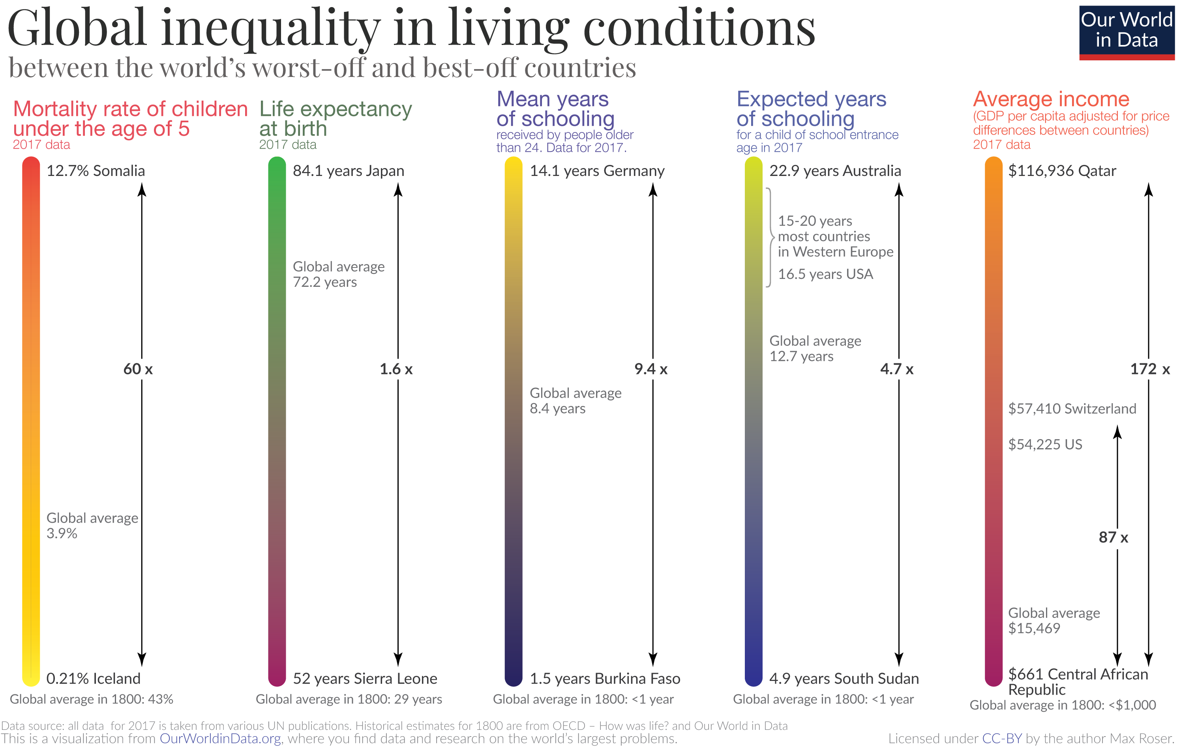

Slide 10
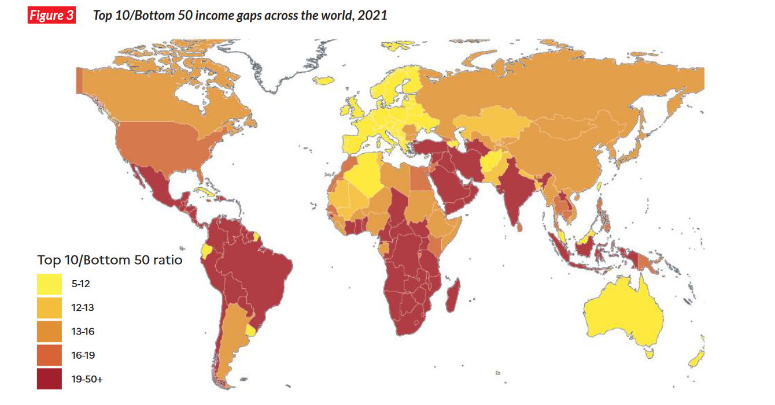

Slide 11
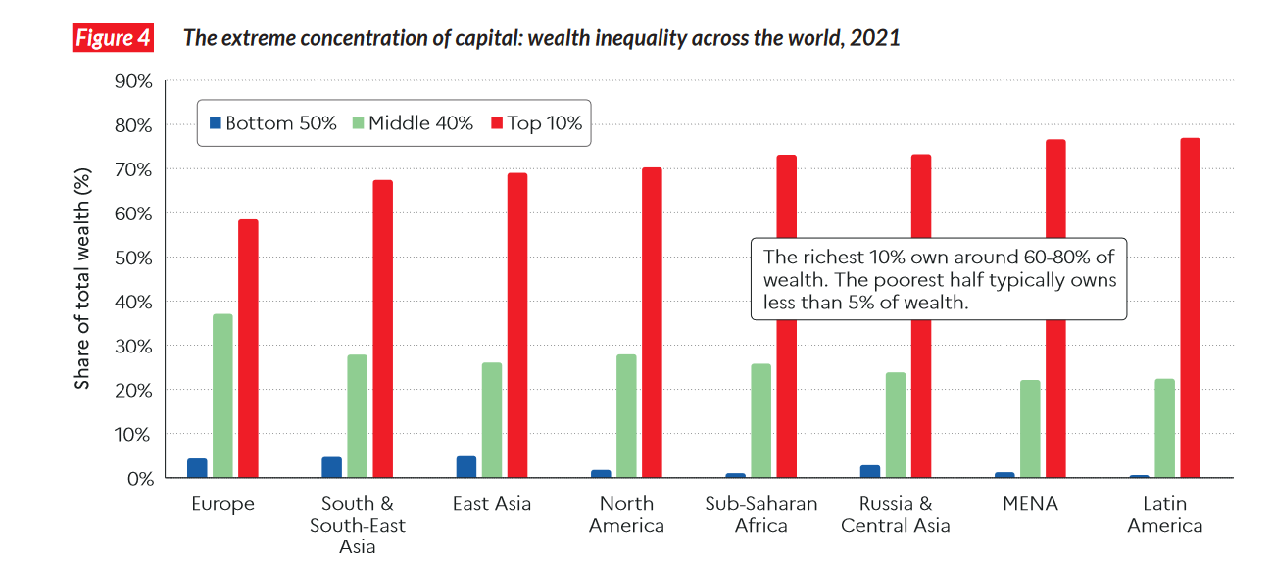

Slide 12
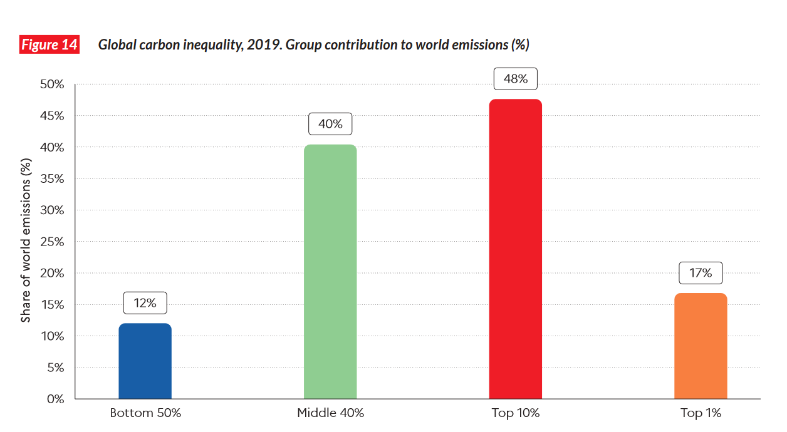

Slide 13
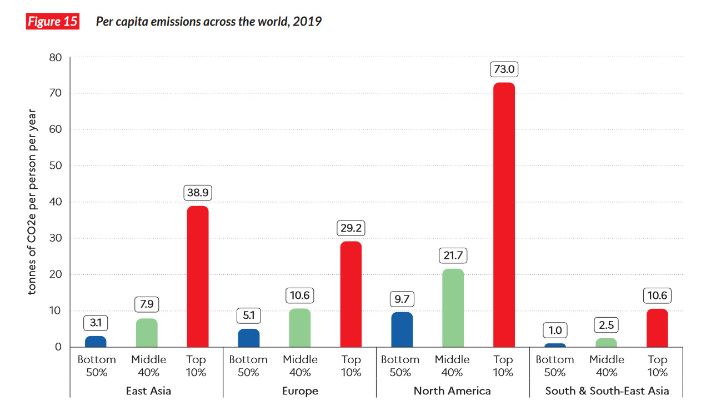

Slide 14
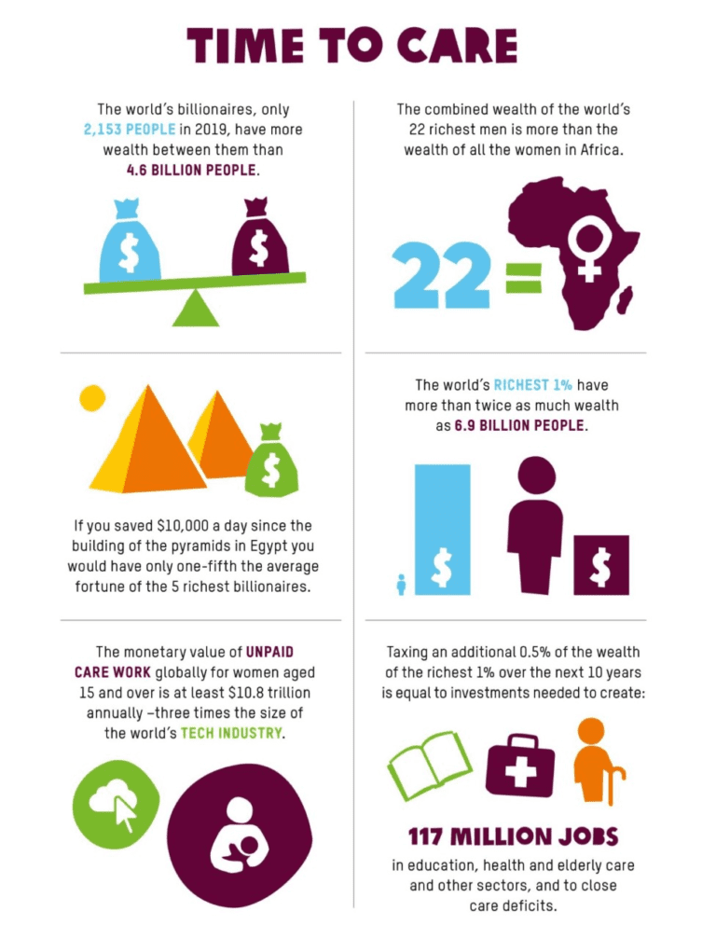

Slide 15
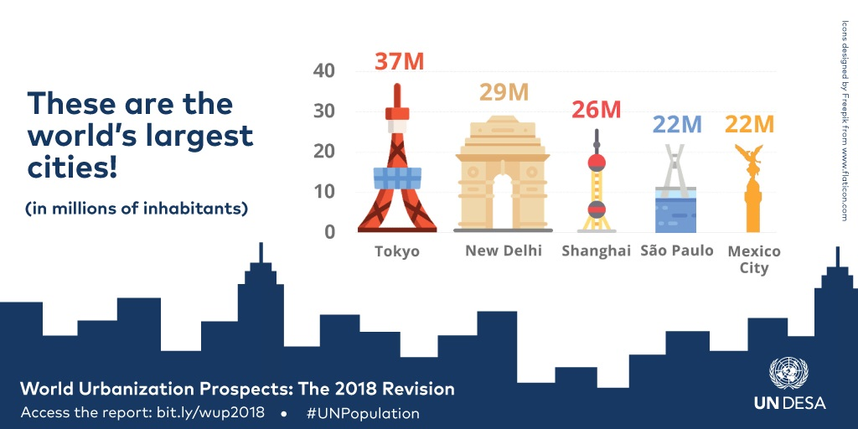

Slide 16
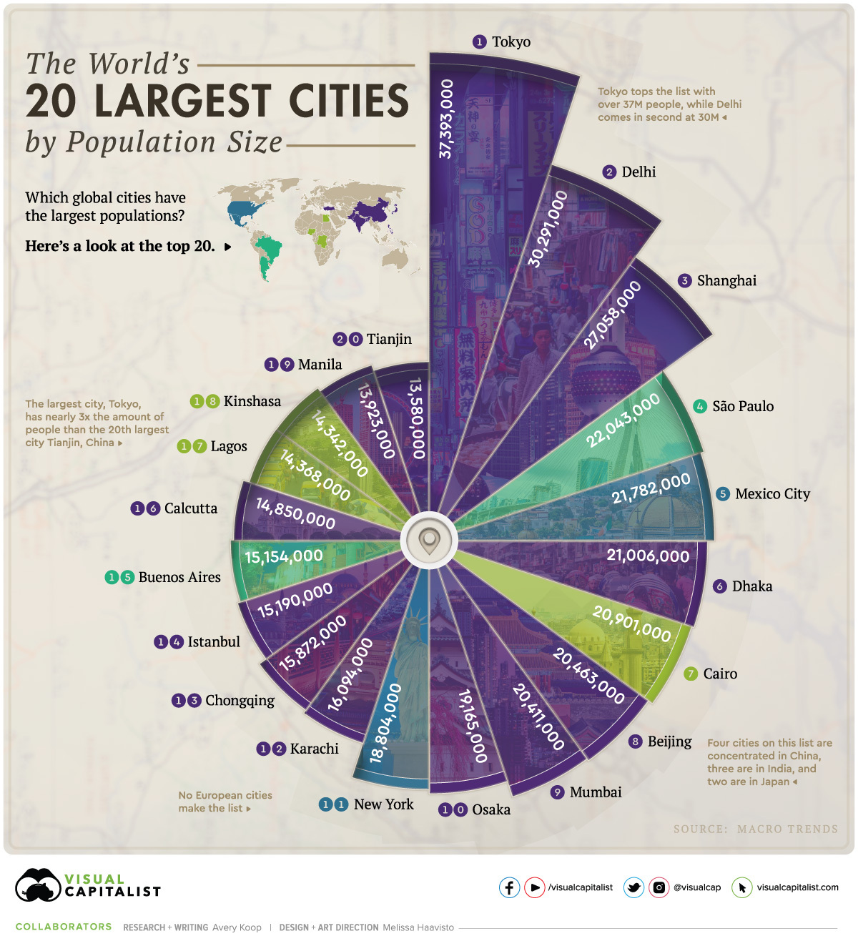
- Urbanization offers unmatched opportunities, yet cities find poverty and wealth in close proximity, making high and growing levels of inequality all the more glaring.
- The high concentration of people and businesses has favourable impacts but causes several problems (economic, environmental, transportation, housing, crime etc.).
- However, rural areas, especially in the low-income countries are also hot spots, meaning areas in the focus of spatial policies.

Slide 17
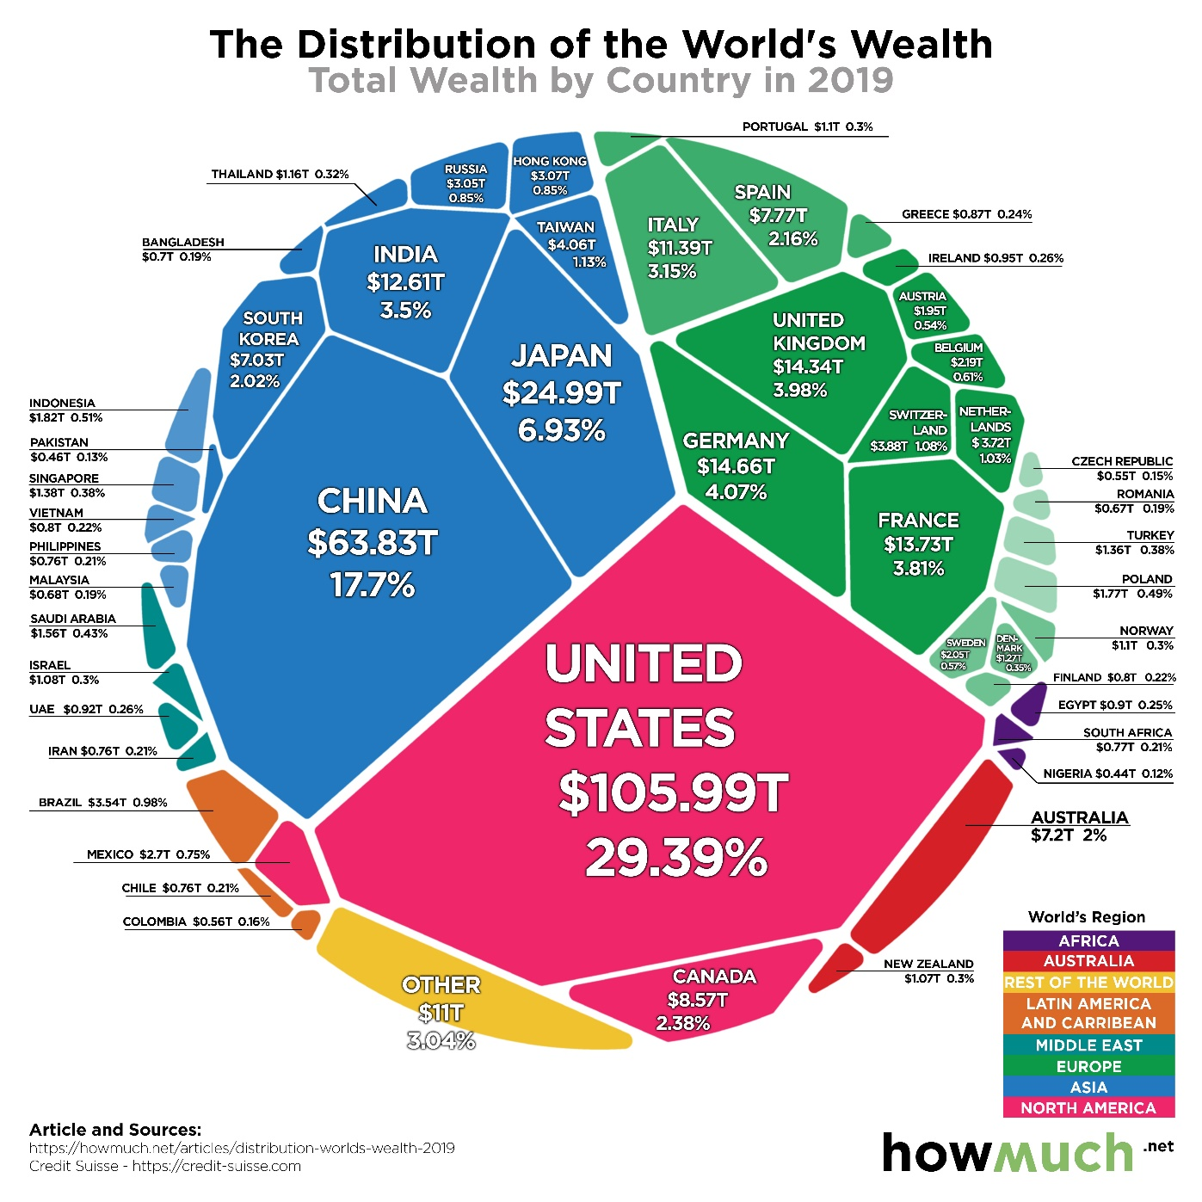

Slide 18
Income inequalities in the European Union

Slide 19
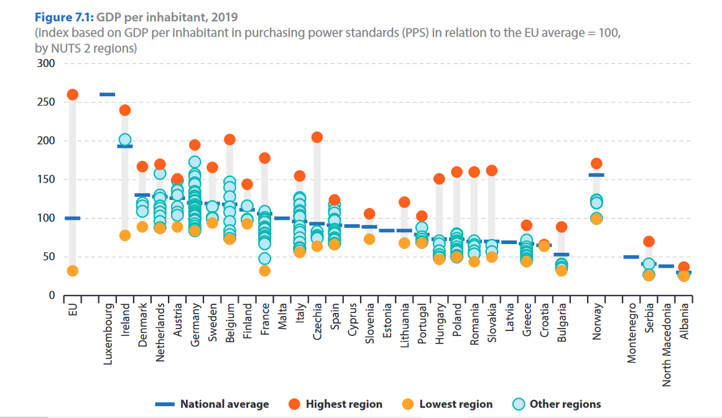

Slide 21
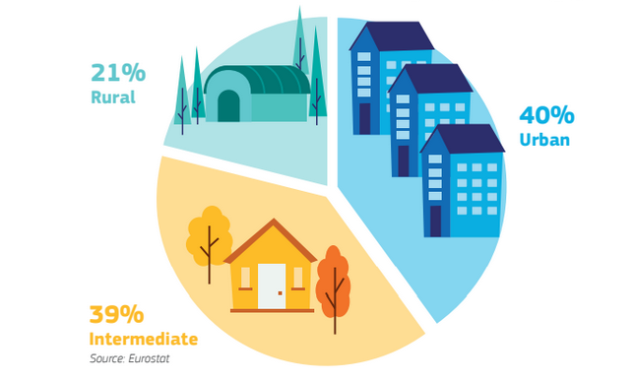
Urban-rural typology of the European Union
- high share of the population (approx. 100 million citizens) live in predominantly rural areas, covering 45% of the territory - the income level in the rural areas are lower than in the urban areas in general but there might be significant territorial inequalities even between those regions - agriculture, tourism (especially agrotourism, rural tourism, ecotourism), SMEs are primarily in rural areas - demographic characteristics (a higher share of elderly population) and geographic features (larger distances to access health care centres), coupled with reduced health care staff and facilities, definitely hamper the ability of rural regions to respond to the challenges, e.g. the pandemic.

Slide 22
Challenges of rural areas in the mirror of COVID-19
A high share of workers in essential jobs (agriculture, food processing, etc.) coupled with a limited capability to undertake these jobs from home. This makes telework and social distancing much harder to implement.
A large share of population who are at higher risk for severe illness, notably the elderly and the poor.
A much less diversified economy.
Lower incomes and lower savings may have forced rural people to continue to work and/or not visit the hospital when needed.
A large digital divide, with lower accessibility to internet (both in coverage and connection speed) and fewer people with adequate devices and the required skills to use them.
.
.
.

Slide 23
Shrinking rural population in the EU (not the shrinking of population with low income!)
The populations’ transfers from rural to intermediate areas lead to the constant shrinkage of certain rural regions.
In 8 (out of 27) Member States, rural regions have been constantly losing population since 1991; all these rural regions are located in Bulgaria, Croatia, Hungary, Portugal and Romania and the three Baltic States.
Rural depopulation brings a main challenge for agriculture, in relation with generational renewal.
The lack of attractivity of rural areas leads not only to a lack of young farmers but also to land abandonment and increased risk of forest fires, which is typically threatening for mountain areas and pastoral economy.

Slide 24
Why is it important to help the regions lagging behind to catch up?
It takes more time and costs more money if we need to solve the problem of poor regions while the gap is increasing further
If there are more and more regions lagging behind and the standard of living is poorer and poorer,
less and less population is part of the solvent market (if they cannot afford to buy the necessary product and services, they are not part of the active market – shrinking market),
more people tend to migrate from the underdeveloped regions to the more developed urban areas (causing tension in the towns – pollution, problems of housing, job market problems for the underqualified workforce etc.)
crime may be a threatening factor

Slide 25
Why focus on rural areas?
they have important role in mitigating the effects of climate change, protecting the natural resources
they play important role in producing high quality food and non-food products
they contribute to the richness and diversity of the countries
they can help to avoid overpopulation in cities
they can provide alternatives to fossil fuels
they can contribute to circular economy
COVID-19 crisis has introduced significant changes to society (increased teleworking, appreciation for green spaces, avoiding crowded places) which rural areas could benefit from
Therefore innovative, inclusive and sustainable solutions have to be explored in the light of climate and digital transformation and the COVID-19 crisis, with primary focus on the uniqueness of the areas, on local values.

Slide 26
Future of rural areas?
The pandemic has changed consumption and production patterns, remote working habits and forms of mobility, which may open new opportunities for sustainable growth in rural regions.
There may be a shift in buying habits to favour local goods and tourism sites, as well as production from small local businesses and primary producers. E.g., in terms of tourism, overcrowded destinations might see high reductions in tourism flows, while smaller rural destinations may become more popular.
The positive effect of lockdown measures on pollution and CO2 emissions levels could lead to increased social demands for policies to support green and sustainable growth.
Supporting countries in developing pathways for climate conscious rural economic development will be key to the recovery of COVID-19.
Mobilize and strengthen local networks, cooperatives to face future shocks

Slide 27
There is no one-size-fits-all solution... - Development strategies based on endogenous, local values and conditions are needed - The development paths of regions are open-ended (there is no maximum level of development) - Regions can develop parallel (if one region develops, it does not automatically prevent other regions from development)

Slide 28
Endogenous development includes
a territorial and integrated focus;
the use of local resources; and
local contextualisation through active public participation.
‘local development produced mainly by local impulses and grounded largely on local resources’
Thereby, the rural perspective on endogenous development puts a higher emphasis on social aspects than other concepts of endogenous development.
Endogenous development draws attention to the distinction between local and external actors having control of the development process (Lowe et al., 1995) with the endogenous model favouring a ‘mosaic’ of local action (Ray, 2006).

Slide 29
EU regional/cohesion policy
Over 30% of the EU’s total budget is allocated to this policy
The 2nd policy after the Common Agricultural Policy (in terms of allocated budget)
Aim: cohesion among the regions, harmonized development within the EU
Five main objectives will drive EU investments in 2021-2027:
Regional development investments will strongly focus on objectives 1 and 2. 65% to 85% of ERDF and Cohesion Fund resources will be allocated to these priorities, depending on Member States’ relative wealth.
Smarter Europe, through innovation, digitalisation, economic transformation and support to small and medium-sized businesses.
a Greener, carbon free Europe, implementing the Paris Agreement and investing in energy transition, renewables and the fight against climate change.
a more Connected Europe, with strategic transport and digital networks.
a more Social Europe, delivering on the European Pillar of Social Rights and supporting quality employment, education, skills, social inclusion and equal access to healthcare.
a Europe closer to citizens, by supporting locally-led development strategies and sustainable urban development across the EU.

Slide 30
Cont.
Cohesion Policy keeps on investing in all regions, still on the basis of 3 categories (less-developed; transition; more-developed).
The allocation method for the funds is still largely based on GDP per capita. New criteria are added (youth unemployment, low education level, climate change, and the reception and integration of migrants) to better reflect the reality on the ground. Outermost regions will continue to benefit from special EU support.
Cohesion Policy supports locally-led development strategies and empowers local authorities in the management of the funds. The urban dimension of Cohesion Policy is strengthened, with 6% of the ERDF dedicated to sustainable urban development, and a new networking and capacity-building programme for urban authorities, the European Urban Initiative.

Slide 31
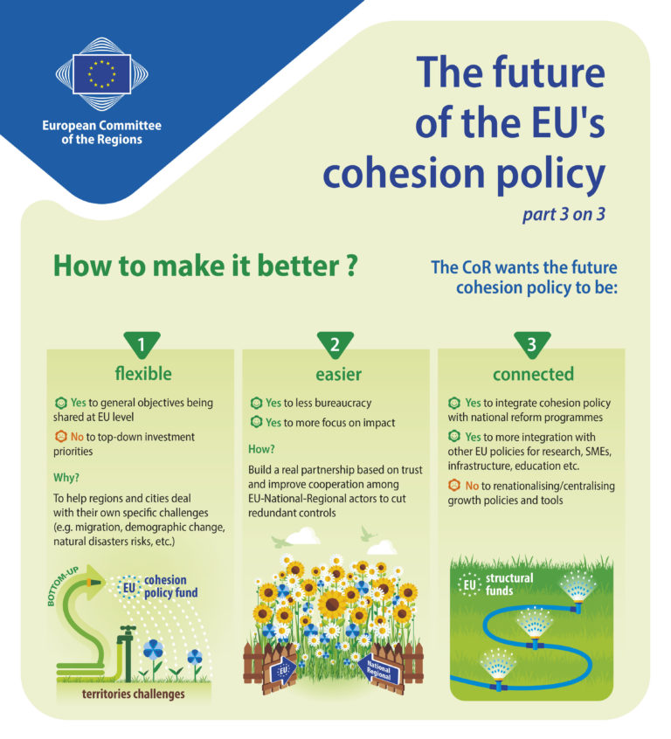

Slide 32
Cohesion policy provides most of its financial support to the regions that are lagging behind, recognising that the economic and social development of these territories will generate a spill-over effect in the more developed regions.
Programming over a longer time span of seven years provides greater stability of investments than any national budget cycle and ensures that emerging one-off events and crises do not divert focus away from long-term development goals.
In the challenging yeas ahead, the synergies between cohesion and reform efforts will have to be further strengthened and maximised, taking into account the regional specificities.
The added value of post-crisis recovery investments powered by NextGenerationEU and traditional cohesion investments will lie particularly in tailoring investments to each region’s needs — from basic infrastructure and digital education facilities in some to state-of-the art artificial intelligence applications in others.

Slide 33
Local Economic Development (LED)
Communities, cities and governments around the world increasingly turn to Local Economic Development (LED) strategies in response to the challenges of globalization and the drive for decentralization.
LED means more than just economic growth. It is promoting participation and local dialogue, connecting people and their resources for better employment and a higher quality of life for both men and women.

Slide 34
LEADER approach
LEADER: Liaison Entre Actions pour le Développement de l’Economie Rurale – Links between the rural economy and development actions.
Over the past 20 years, the LEADER approach to community-led local development (CLLD), has helped rural actors consider the long-term potential of their local region, and proven an effective and efficient tool in the delivery of development policies.
In Europe, since the 1990s, much of the focus in rural development practice has been targeted on local action and endogenous (‘emerging from within’) development initiatives, exemplified by the European Union’s LEADER Programme.
In practice, LEADER put at the heart of the development process autonomous local action groups (LAGs) ‘working in partnership’ across public, private and voluntary sectors.

Slide 35
Community-led Local Development
CLLD is based on the 7 LEADER principles which are all equally important to ensuring the success of the approach and, in particular, responding to local needs in a targeted way that top-down approaches to socio-economic development cannot.

Slide 36
CLLD is based on 3 interconnected elements:
local action groups (representatives of public and private local socio-economic interests)
integrated local development strategies
well-defined territories
CLLD is a specific tool for use at sub-regional level, which is complementary to other development support at local level.
CLLD can mobilise and involve local communities and organisations to contribute to achieving the Europe 2020 Strategy goals of smart, sustainable and inclusive growth, fostering territorial cohesion and reaching specific policy objectives.

Slide 37
A single methodology regarding CLLD which…
focuses on specific sub-regional areas;
is community-led, by local action groups composed of representatives of local public and private socio-economic interests;
is carried out through integrated and multi-sectoral area-based local development strategies, designed taking into consideration local needs and potential; and
takes into consideration local needs and potential, includes innovative features in the local context, networking and, where appropriate, co-operation.
This single methodology will allow for connected and integrated use of the Funds to deliver local development strategies.

Slide 38
The aims of CLLD are to…
encourage local communities to develop integrated bottom-up approaches in circumstances where there is a need to respond to territorial and local challenges calling for structural change;
build community capacity and stimulate innovation (including social innovation), entrepreneurship and capacity for change by encouraging the development and discovery of untapped potential from within communities and territories;
promote community ownership by increasing participation within communities and build the sense of involvement and ownership that can increase the effectiveness of EU policies; and
assist multi-level governance by providing a route for local communities to fully take part in shaping the implementation of EU objectives in all areas.

Slide 39
The key components of CLLD
The local action groups should be made up of representatives of local public and private socio-economic interests, such as entrepreneurs and their associations, local authorities, neighbourhood or rural associations, groups of citizens (such as minorities, senior citizens, women/men, youth, entrepreneurs, etc.), community and voluntary organisations, etc.
At least 50 % of the votes in selection decisions should be cast by partners which are not public authorities and no single interest group should have more than 49 % of the votes.

Slide 40
Cont.
2. The local development strategies need to be coherent with the relevant programmes of the ESI Funds through which they are supported.
They should define the area and population covered by the strategy; include an analysis of the development needs and potential of the area, including a Strengths, Weaknesses, Opportunities, Threats (SWOT) analysis; and describe the objectives, as well as the integrated and innovative features of the strategy, including measurable targets for outputs or results.
The strategies should also include an action plan demonstrating how objectives are translated into concrete projects, management and monitoring arrangements, and a financial plan.

Slide 41
Cont.
3. The area and population coverage of a given local strategy should be coherent, targeted and offer sufficient critical mass for its effective implementation.
It is up to the local action groups to define the actual areas and population that their strategies will cover, but they must be consistent with criteria that are laid down in Article 33(6) of the Common Provisions Regulation.
The population coverage should be minimum 10 000 and maximum of 150 000 which is in line with the 2007-2013 provisions under the LEADER programme.
The Commission may accept derogations to amend these limits in duly justified cases on the basis of a proposal by a Member State. For reference, the average population concerned by the URBAN II programmes funded by the ERDF in the 2000-2006 period was approximately 30 000 inhabitants.

Slide 42
CLLD is not only for rural areas (urban CLLD)
It may be used…
to reduce CO2 in neighbourhoods,
to generate energy,
to develop a sharing and more circular economy,
to integrate migrants and build social cohesion,
to create local jobs,
to tackle homelessness,
to tackle drug dealing and street crime,
to improve health and wellbeing,
to create and manage parks and allotments and
to grow food.

Slide 43
Focus of social inclusion CLLD
Tackling social exclusion and unemployment
Combatting homelessness
Marginalised communities
Migrant integration
Enterprising communities: social enterprise and business creation
Financial inclusion and microcredit
Youth initiatives
Healthy communities
Active ageing

Slide 44
Local coordinators, local „heroes” needed
Without local coordinators/leaders, who are committed to local development, are proactive, know the local values and conditions, are aware of the local needs, are acknowledged by the local players, DEVELOPMENTS CANNOT BE SUSTAINABLE BUT!!!
THERE IS NO LIST OF CHARACTERISTICS, PERSONALITY FEATURES, SKILLS, QUALIFICATIONS OF LOCAL LEADERS THAT WOULD BE COLLECTED AND ACKNOWLEDGED INTERNATIONALLY SO THAT ANYONE COULD HAVE A MIRROR ABOUT SUITABILITY
THERE ARE NO TRAININGS, COURSES TARGETED FOR MAYORS, LEADERS, LOCAL GOVERNMENT OFFICIALS ETC. ABOUT THE LOCAL DEVELOPMENT APPROACHES
Even if there are qualifications obtained, there are still senses, emotional relationships, commitment to the target area that cannot be taught and studied
Local coordinators need to combine the skills of empathy and diplomacy while being organiser, realist and dreamer (it is perhaps the hardest role in development).
The typical coordinator needs to combine personal skills with project management skills.
The ideal candidate has an open engaging personality and is at the same time efficient at getting through their to-do list.

Slide 45
The key is in the principle of subsidiarity
Problems should be solved at the smallest and most initimate level possible
Decisions should be made as close to people as possible
Application of subsidiary principle has 3 advantages:
Local decision-making improves efficiency, promotes self-reliance at local level, encourages competition and nurtures innovation
Democracy is based on three assumptions: all citizens are equal, the citizen is the ultimate sovereign, the citizen has the capacity to decide what is in his best interest.
Once decision-making and its consequences are integrally linked at local level, people can better appreciate that hard choices need to be made.

Slide 46
Why circular economy?
The circular economy fundamentally changes our economic model.
It moves away from the linear “take, make, dispose” route towards a more sustainable and equitable system.
The circular economy seeks to reduce waste, promote reuse and recycling, and foster innovation and creativity. And it could have important consequences for less populous places.
First, the circular economy has the potential to create jobs and drive economic growth by empowering the repair sector and refurbishment of goods.
Promoting sustainable farming methods as a way to reduce waste can protect the environment and benefit local producers.
Investing in renewables and energy efficiency decreases our dependence on fossil fuels.
In a circular economy, waste is the new raw material. A product’s life is no longer a straight line from being produced to being consumed and then discarded.
This saves raw materials, the environment and reduces CO₂ emissions. It stimulates innovation, new business activity and employment.

Slide 47
New approaches
In a circular economy, manufacturers design products to be reusable.
Consumers can choose to share products they only use occasionally, such as a power drill or a car, instead of buying them. This means products are used more intensively, so that fewer products need to be made, reducing raw materials use.
In a circular economy we treat our environment responsibly.
A well-functioning circular economy doesn’t only depend on the government and industry. Consumers, too, have a role to play: choosing sustainable products must become the new standard.
Consumers also contribute to a circular economy by using things longer, repairing them or taking them to a second-hand shop.

Slide 48
Circular economy – rural areas
Despite the decreasing trend of the rural population, the share of 44% of the global population in 2021 highlights that rural regions must be part of circular economy initiatives to meet the SDGs by 2030.
However, there are significant rural–urban gaps in terms of accessibility to a network of basic utilities (waste, sanitation, wastewater, water supply, clean energy), which require rapid actions and multi-level cooperation.
Rural lands and rural populations are the main providers of food and resources for the ever-expanding urban areas.
At the same time, rural communities around the world are facing serious environmental challenges related to climate change, biodiversity loss, and plastic pollution of the natural environment.
Rural communities are examined as plastic pollution destination sites and contributors to plastic pollution. In the latter case, rural communities contribute to plastic pollution due to domestic waste management deficiencies via illegal dumping, open burning practices, and macro- and microplastic pollution of water bodies (marine and freshwater environments).

Slide 49
According to a report published in 2019 by the Ellen MacArthur Foundation, only 9% of the world's economy is circular, meaning that the remaining 91% is still largely based on the traditional linear model of take-make-dispose.
This report also noted that the circular economy could generate $4.5 trillion in economic benefits by 2030, creating new jobs and reducing environmental impacts.
Another report by the Circle Economy organisation estimates that the global circularity rate was around 8.6% in 2019, up from 7.2% in 2015. The report noted that there is still a long way to go in achieving a fully circular economy, but progress is being made in several areas, including circular design, recycling and sharing platforms.
Even though as per above statistics the share of CE is not high, gradually a large number of countries have taken strategies to enter into the circular economy.
In 2016, the Netherlands was one of the first countries in the world to lay down its ambition for a circular economy in policy, by means of the government-wide programme entitled ‘A Circular Economy in the Netherlands by 2050’.

Slide 50
Challenges
Challenges towards building a circular economy are not related to the lack of technical solutions.
Instead, lack of critical scale, cultural barriers, inadequate regulatory frameworks, and a lack of financial resources has been signalled as “major” obstacles by more than one-third of the interviewed governments in the OECD Survey.
3 critical priorities that have been addressed in the survey as future priorities to overcome these barriers are:
(i) increasing the environmental quality and resource efficiency in regions and cities;
(ii) adapting, updating and making sure that policy and regulation are conducive to the transformation from linear to circular; and
(iii) behavioural shifts and awareness-raising
One of the barriers to the development of the circular economy is that producers and consumers do not yet perceive the benefits so evident. Studies also point out that in the business world, the CE concept is still unknown or mainly related to the management of waste and recycling option.

Slide 51
Some examples

Slide 52
Circular Economy Action Plan (2020)
- Moving to circularity requires novel materials and products with new design, new technologies and production processes. Using less material to get the same or higher utility from products is an important part of the shift to circularity.
- High impact materials like concrete will need to be replaced with low impact ones such as ones made of renewable bio-based resources.
- But it's not just about materials, innovation in new business and governance models is just as important.
- Whole value chains and material flows must become circular.
- Digital innovation will be key to making this happen.
- Information on products' environmental performance can empower consumers, who will drive the demand for sustainable solutions.
- Value chain information will facilitate circular collaboration and increase efficiency.
- Research and innovation is crucial to fill knowledge gaps and develop specific technological solutions.

Slide 53
CIRCLE - promoting circular economy in SMEs in rural areas (Finland, Sweden, Luxemburg)
CIRCLE is a transnational cooperation project aimed at promoting circular economy solutions in SMEs in rural areas.
The project comes under the EU's LEADER programme and its objectives are as follows:
- increase knowledge and awareness about circular economy and its potential for enterprises in rural areas
- increase cooperation between local enterprises
- increase international cooperation and create networks, and to enhance existing ways of implementing circular economy.
The project partners have agreed to organise one programme in each country with visits to enterprises, farms and organisations implementing circular economy or innovative environment-friendly solutions.

Slide 54
Nijsen - Netherlands
A project supported by Wageningen University (Netherlands) has created a circular economy in the pig farming sector.
The main idea is to use food waste to feed the animals so that agricultural production can be destined to human consumption.
Nijsen is the only specialist in the Netherlands to process by-products from the food industry into unique Food-For-Feed raw materials with which our feed makes the difference.
The company Nijsen/Granico picks up food waste from pastry and sweets producers and turns them into animal feed. This feed is given to the Kipster farm, which claims to be the most sustainable farm in the planet for their use of solar energy, local sales and monitoring of the GHG emissions and animal wellbeing.

Slide 55
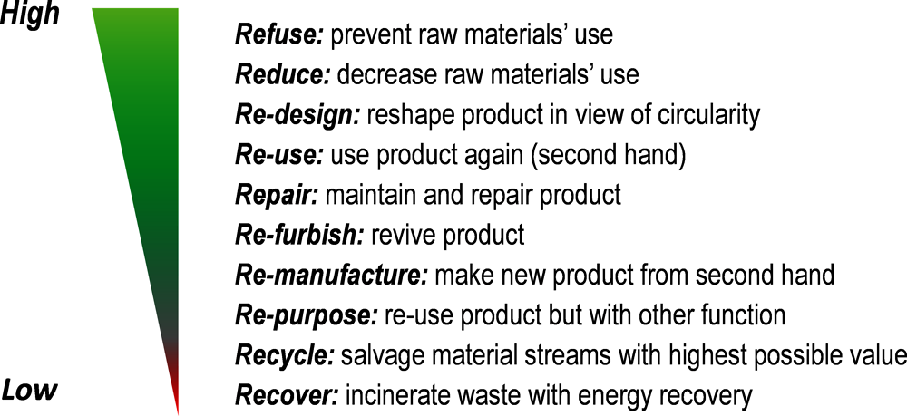
Amsterdam Metropolitan Area
The Amsterdam Metropolitan Area is a comparatively densely populated region with 2.33 million inhabitants.
Large amounts of products and material circulate within the region, and it is home to many innovative and sustainable entrepreneurs.
The Amsterdam Economic Board has initiated a circular economy programme at regional level in January 2015 in close co-operation with the Regional Board of Local Governments, businesses, knowledge institutes, and citizens. Within the programme, 32 municipalities and two regions were engaged in communities of practice.
To stretch the circular ambition of the programme, the aim was to set up activities that focus on the highest possible steps on the ladder of circularity

Slide 56
Circular Economy Villages (CEVs) in Australia
These community-scale, regenerative settlements are powered by a renewable energy micro-grid, while the live and work environments are supported by constructed reservoirs and wetlands, and a diverse, regenerative agricultural system.
The CEVs draw people out of the capital cities — attracted by the healthy lifestyle, lower cost of living and connection to nature.
They also appreciate the benefits of investing in community rather than real estate.
Regenerating natural systems is a key principle of the CEV.
The food and water systems are nature-based infrastructure, designed to integrate with and enhance natural systems.
The collective management of these systems builds social capital and creates a local economy that provides residents with their basic needs—food, water, energy, transport, shelter and work opportunities. This substantially increases local resilience to broader economic, social, political and environmental crises.

Slide 57
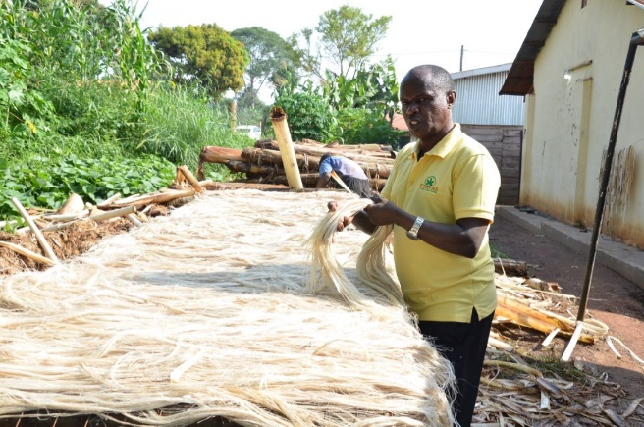
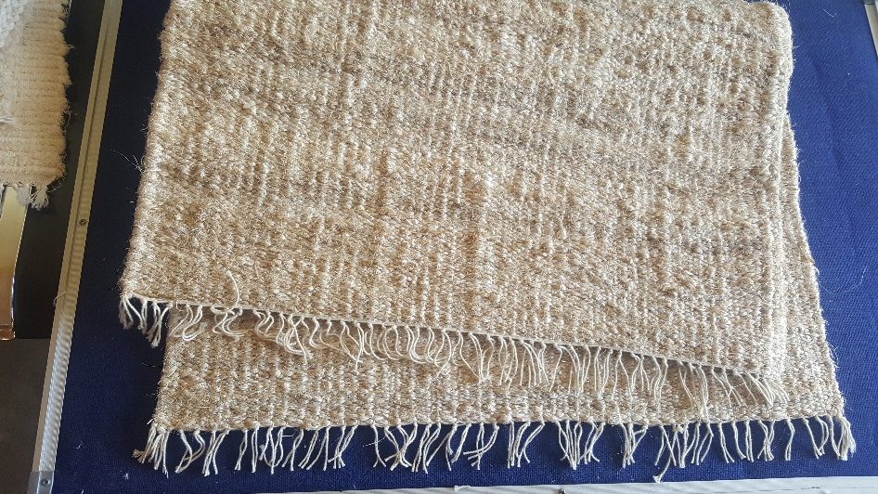
Circular economy in Africa’s rural areas
Uganda is one of the world’s largest banana producer and a world leader in banana consumption. After the harvest, banana stems are usually discarded as waste. TEXFAD has developed technologies for banana fiber extraction and application into production of high quality banana fiber textiles and handicrafts.
They transform waste banana pseudo stems and other waste materials into high quality sustainable textile products.

Slide 58
Thank you very much for your attention!

